Slide 1
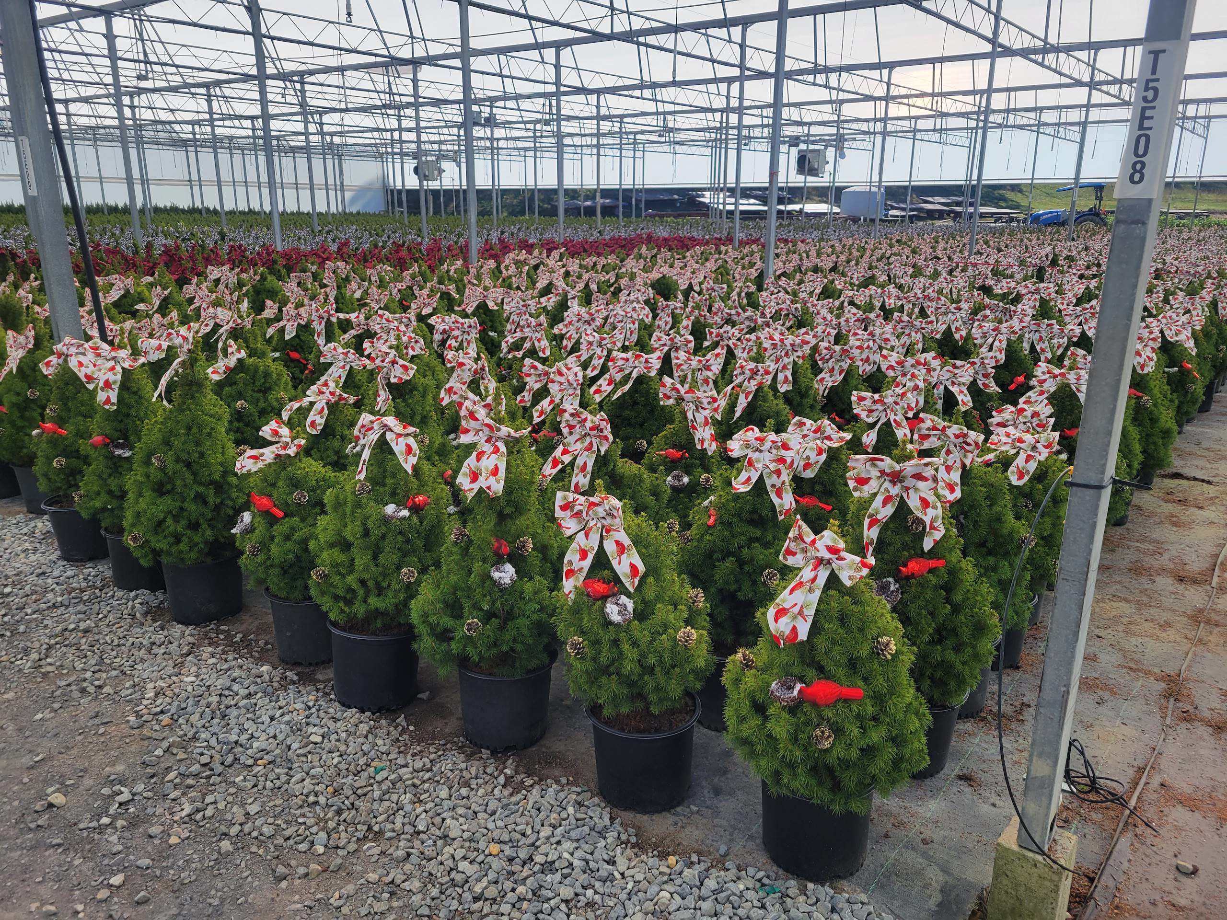
CHRISTMAS 2026

Slide 2
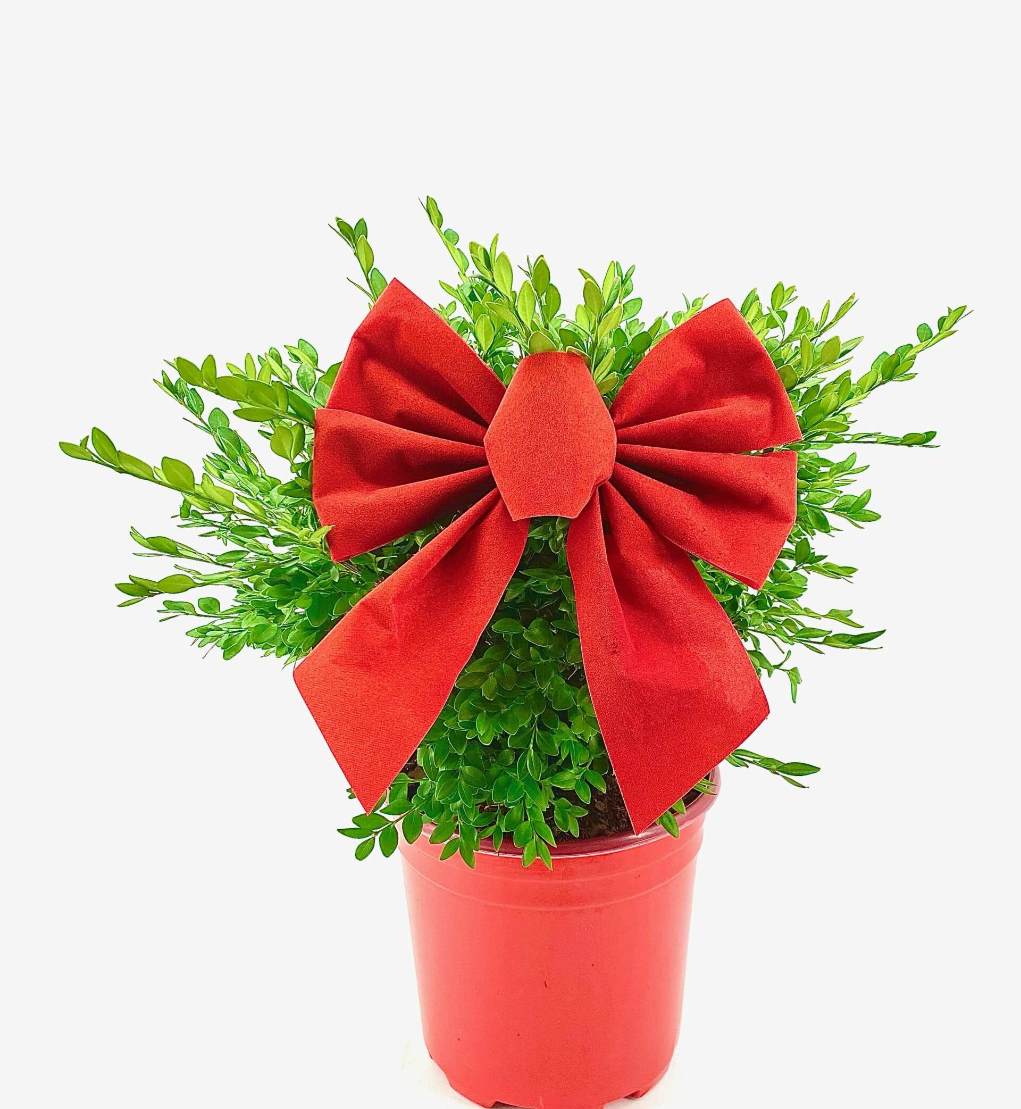
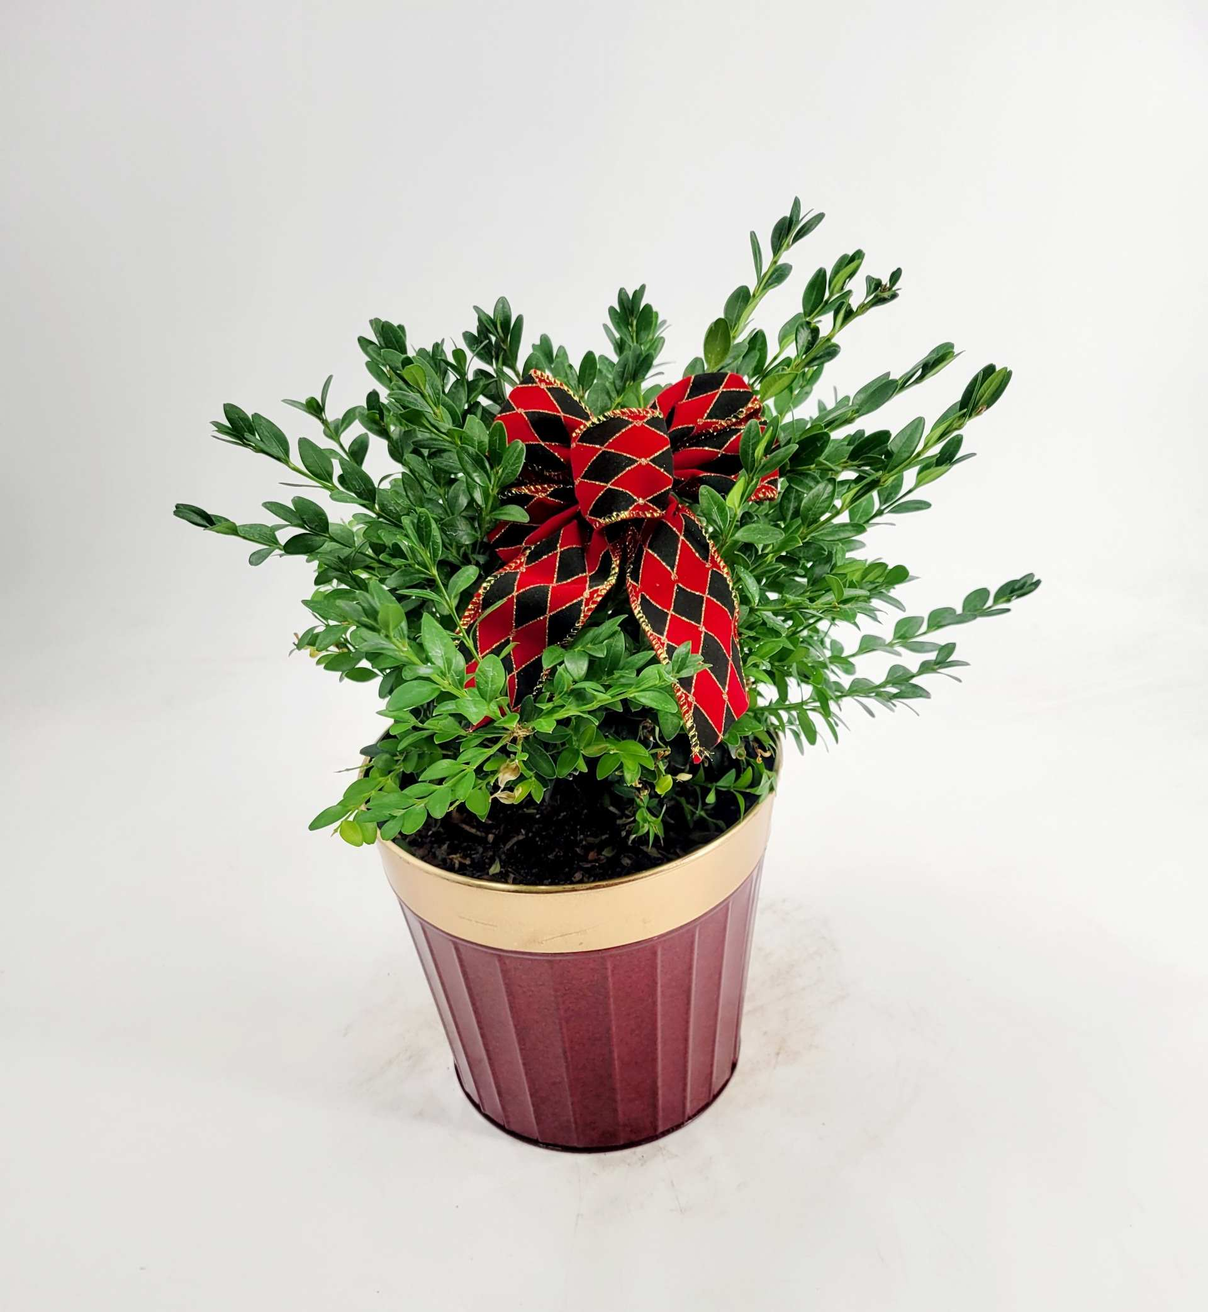
**PLEASE NOTE DECO POT IS DESIGNER’S CHOICE
BUXUS HOLIDAY RED POT 1 CONT.
$12.25
BUXUS HOLIDAY 1 DECO POT
$14.00

Slide 3
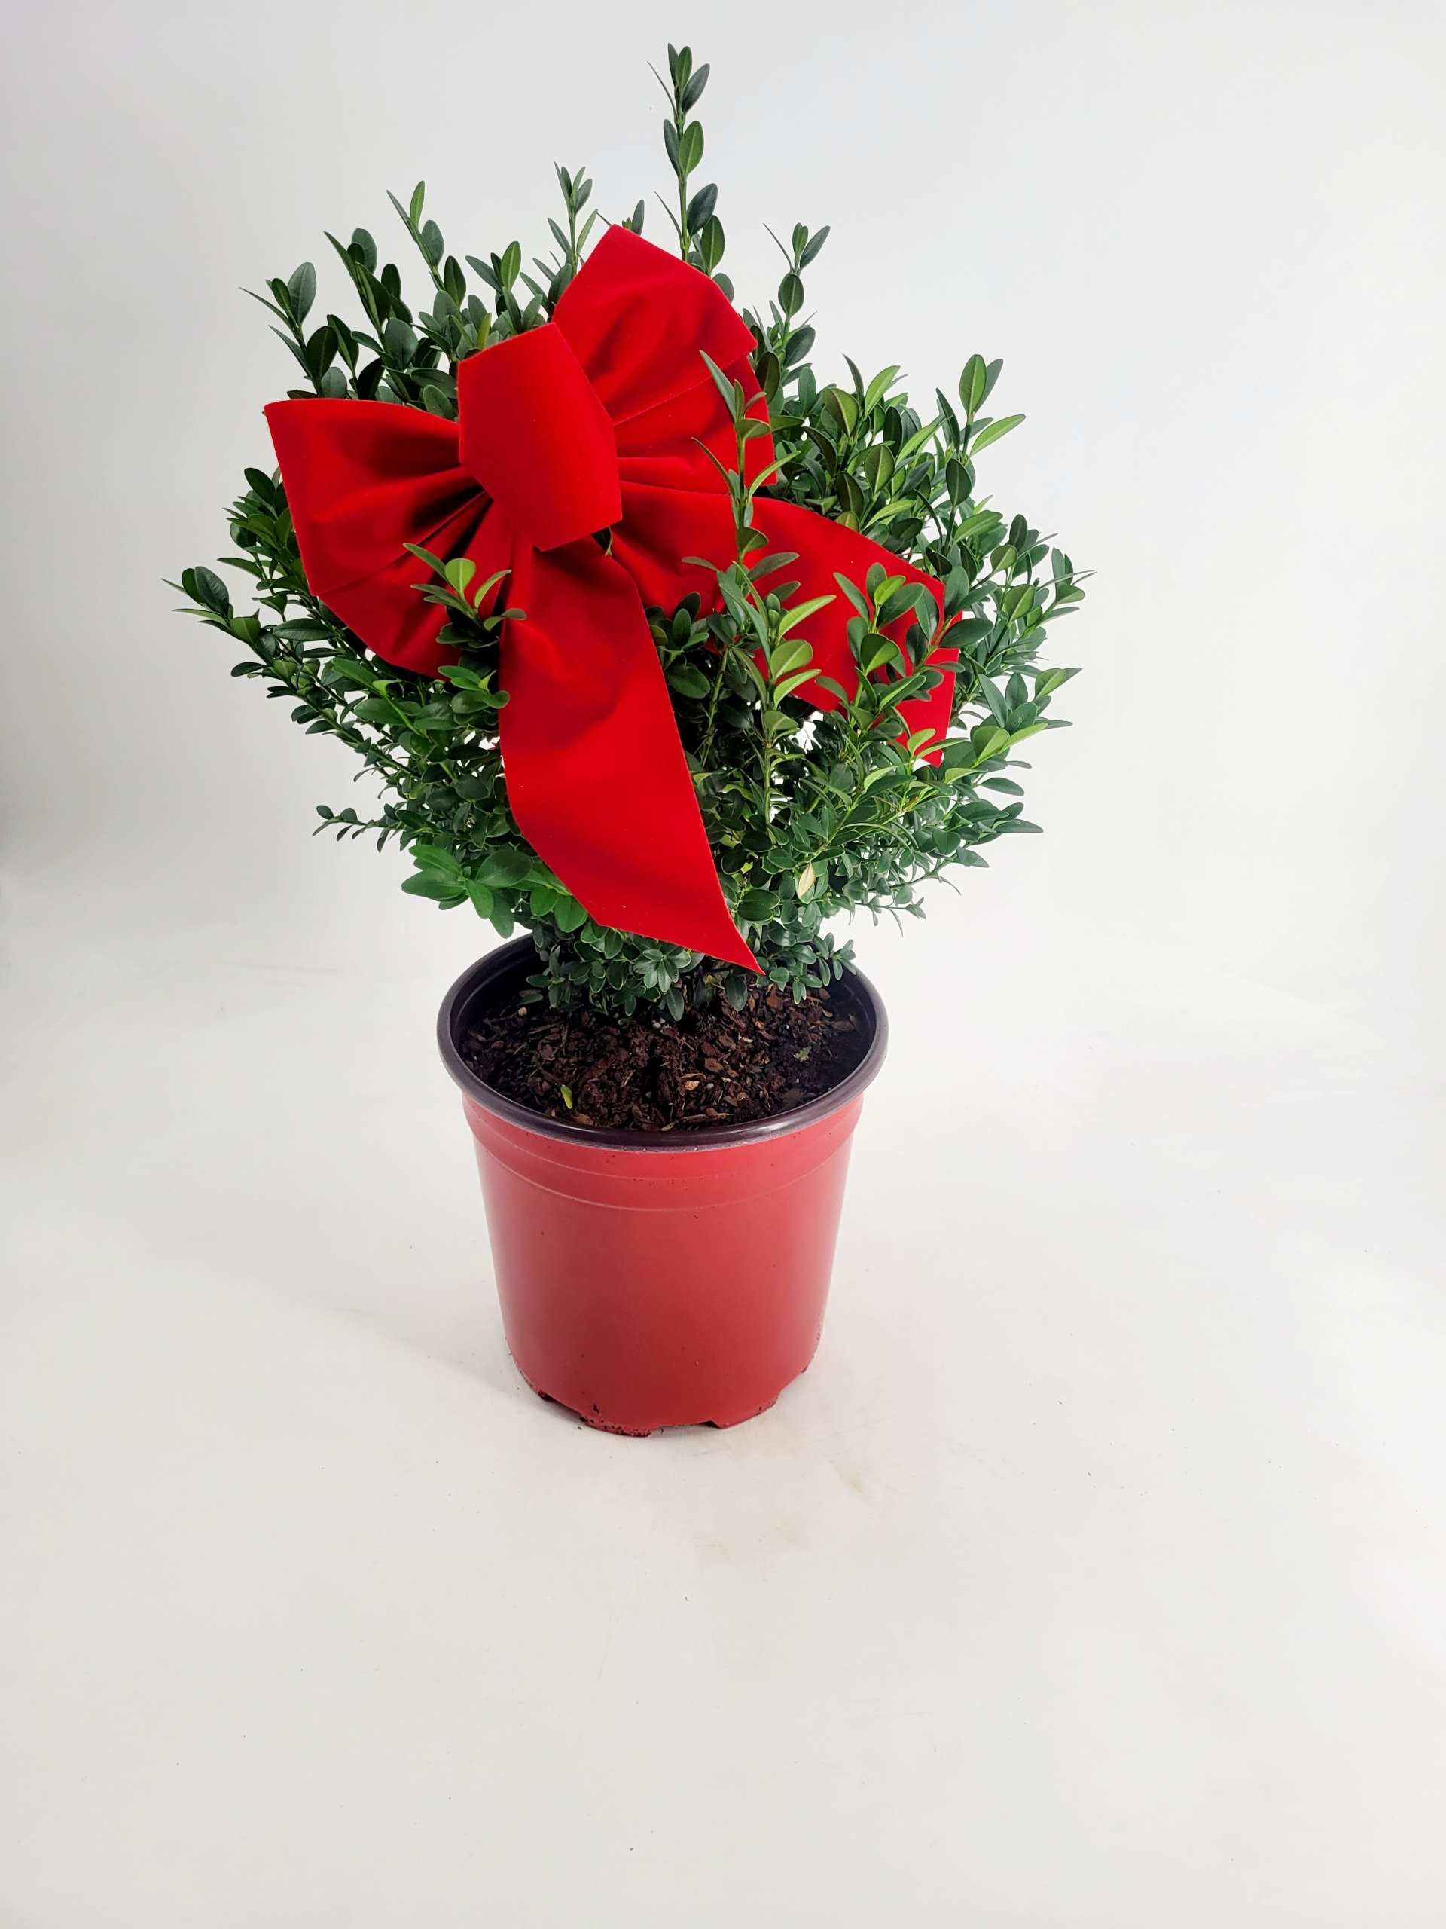
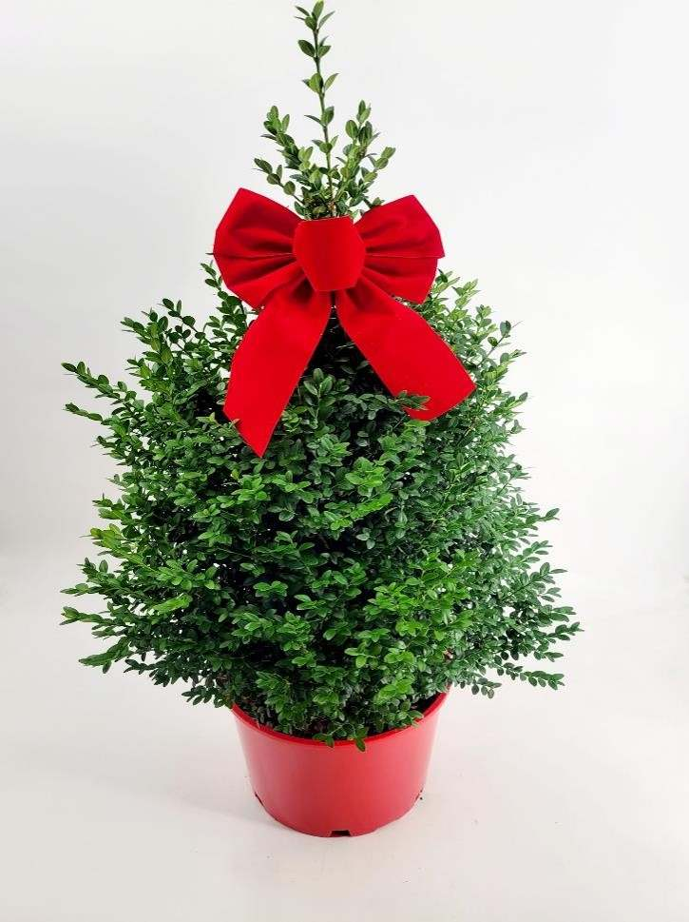
BUXUS HOLIDAY RED POT 2 CONT.
$19.75
BUXUS HOLIDAY RED POT 3 CONT.
$30.00

Slide 4
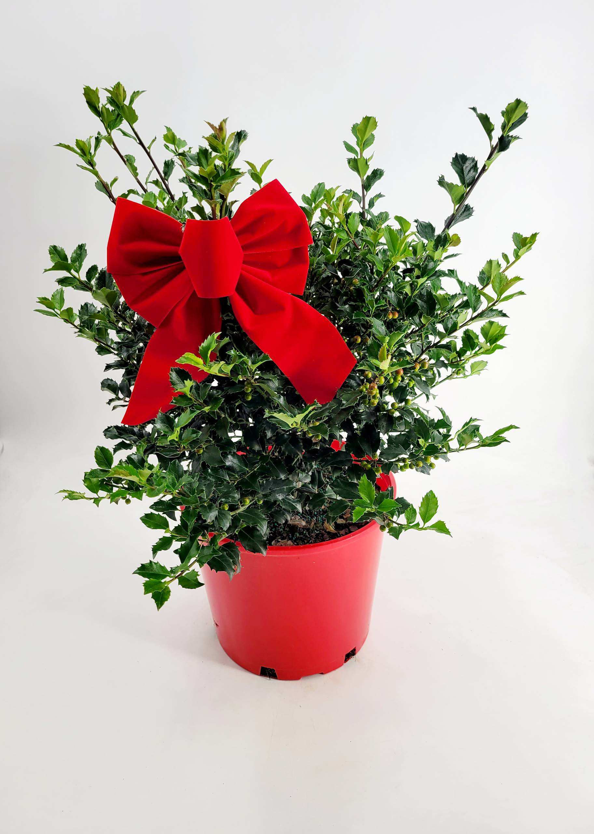
ILEX HOLIDAY RED POT 3 CONT.
$21.75

Slide 5
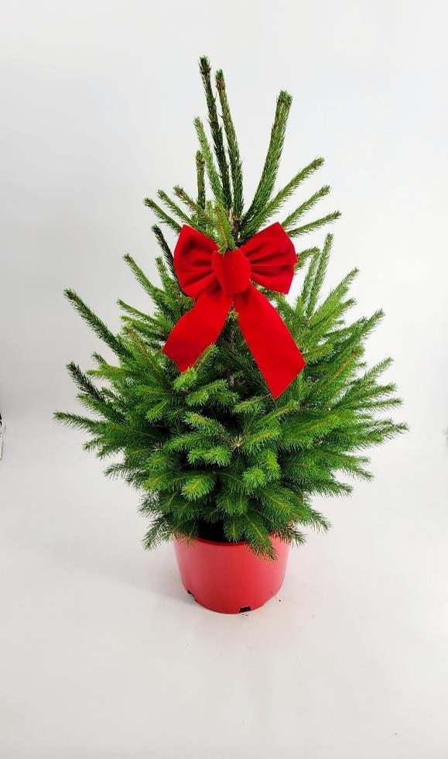
PICEA ABIES #3 HOLIDAY RED POT
$30.00

Slide 6
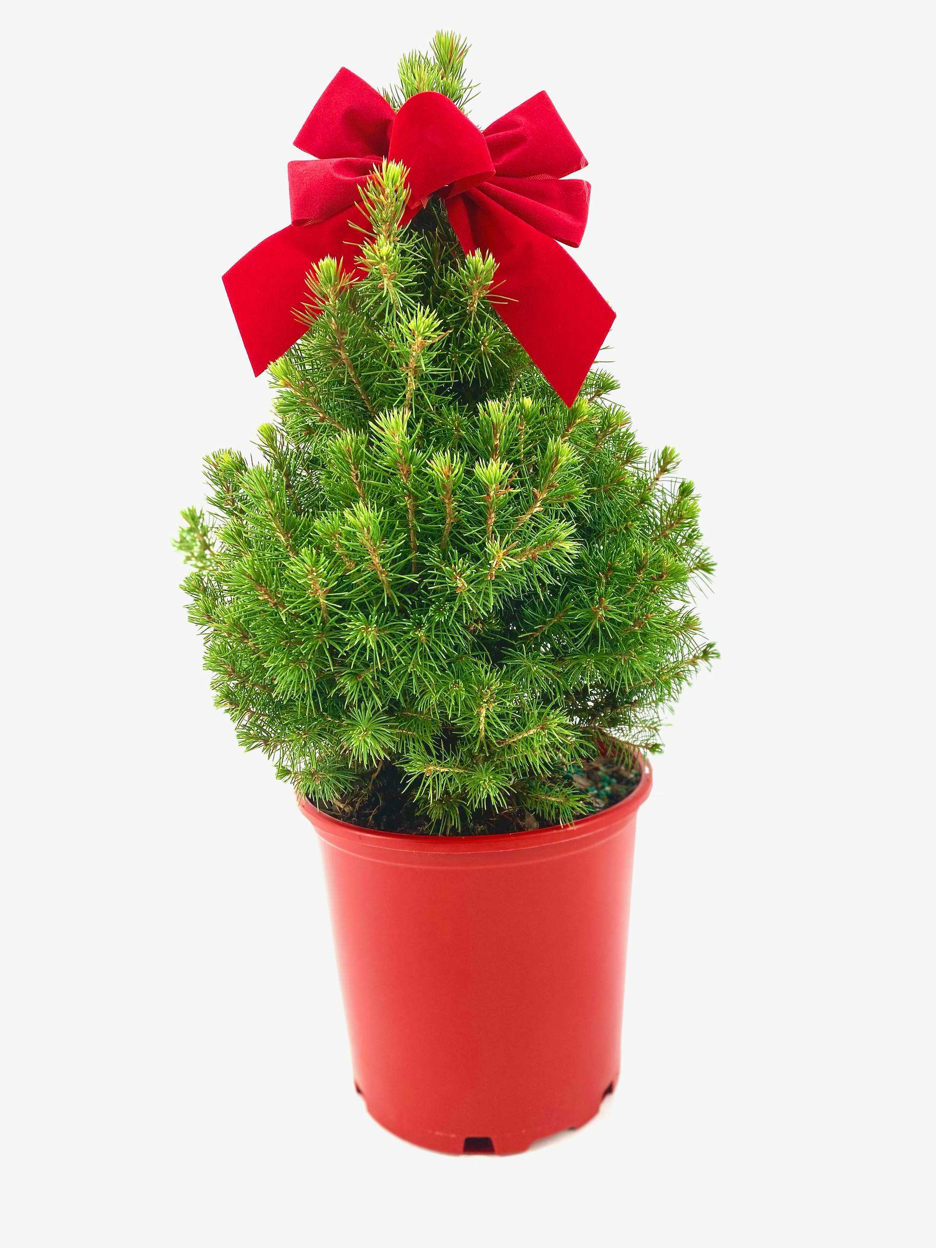
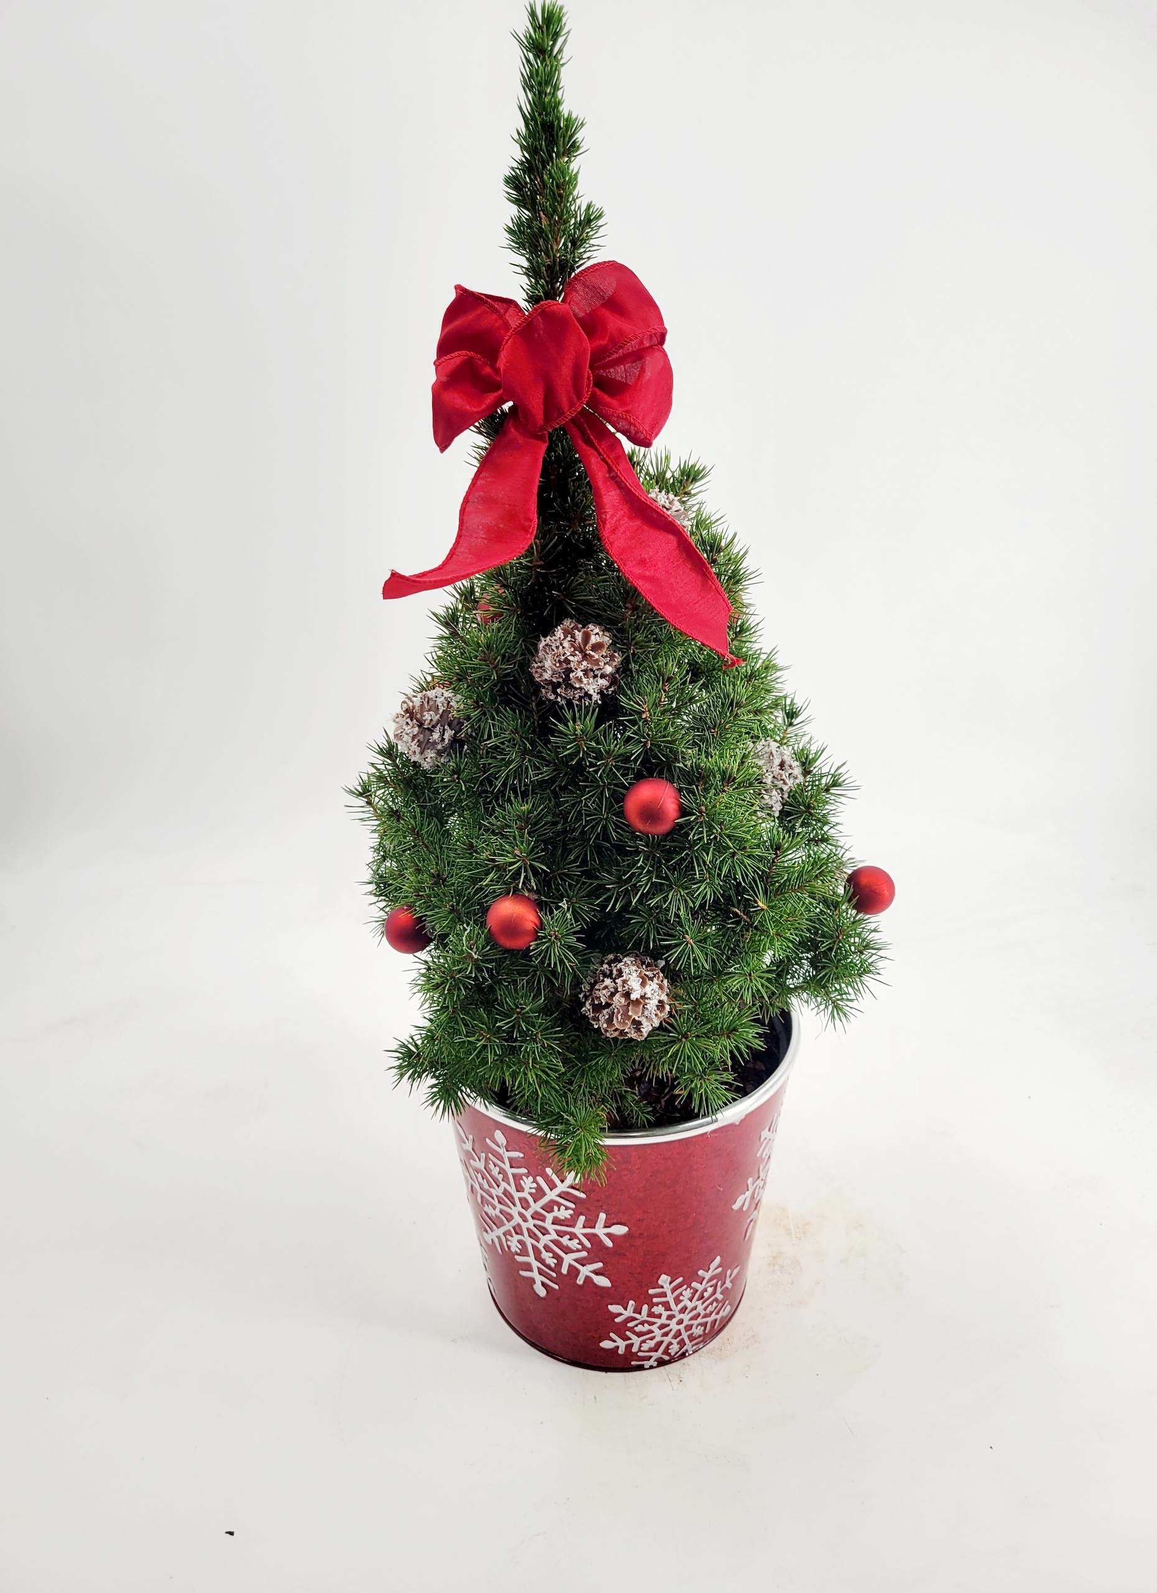
**PLEASE NOTE DECO POT IS DESIGNER’S CHOICE
PICEA HOLIDAY CONICA RED POT 1 CONT.
$11.00
PICEA HOLIDAY CONICA 1 DECO POT
$15.00

Slide 7
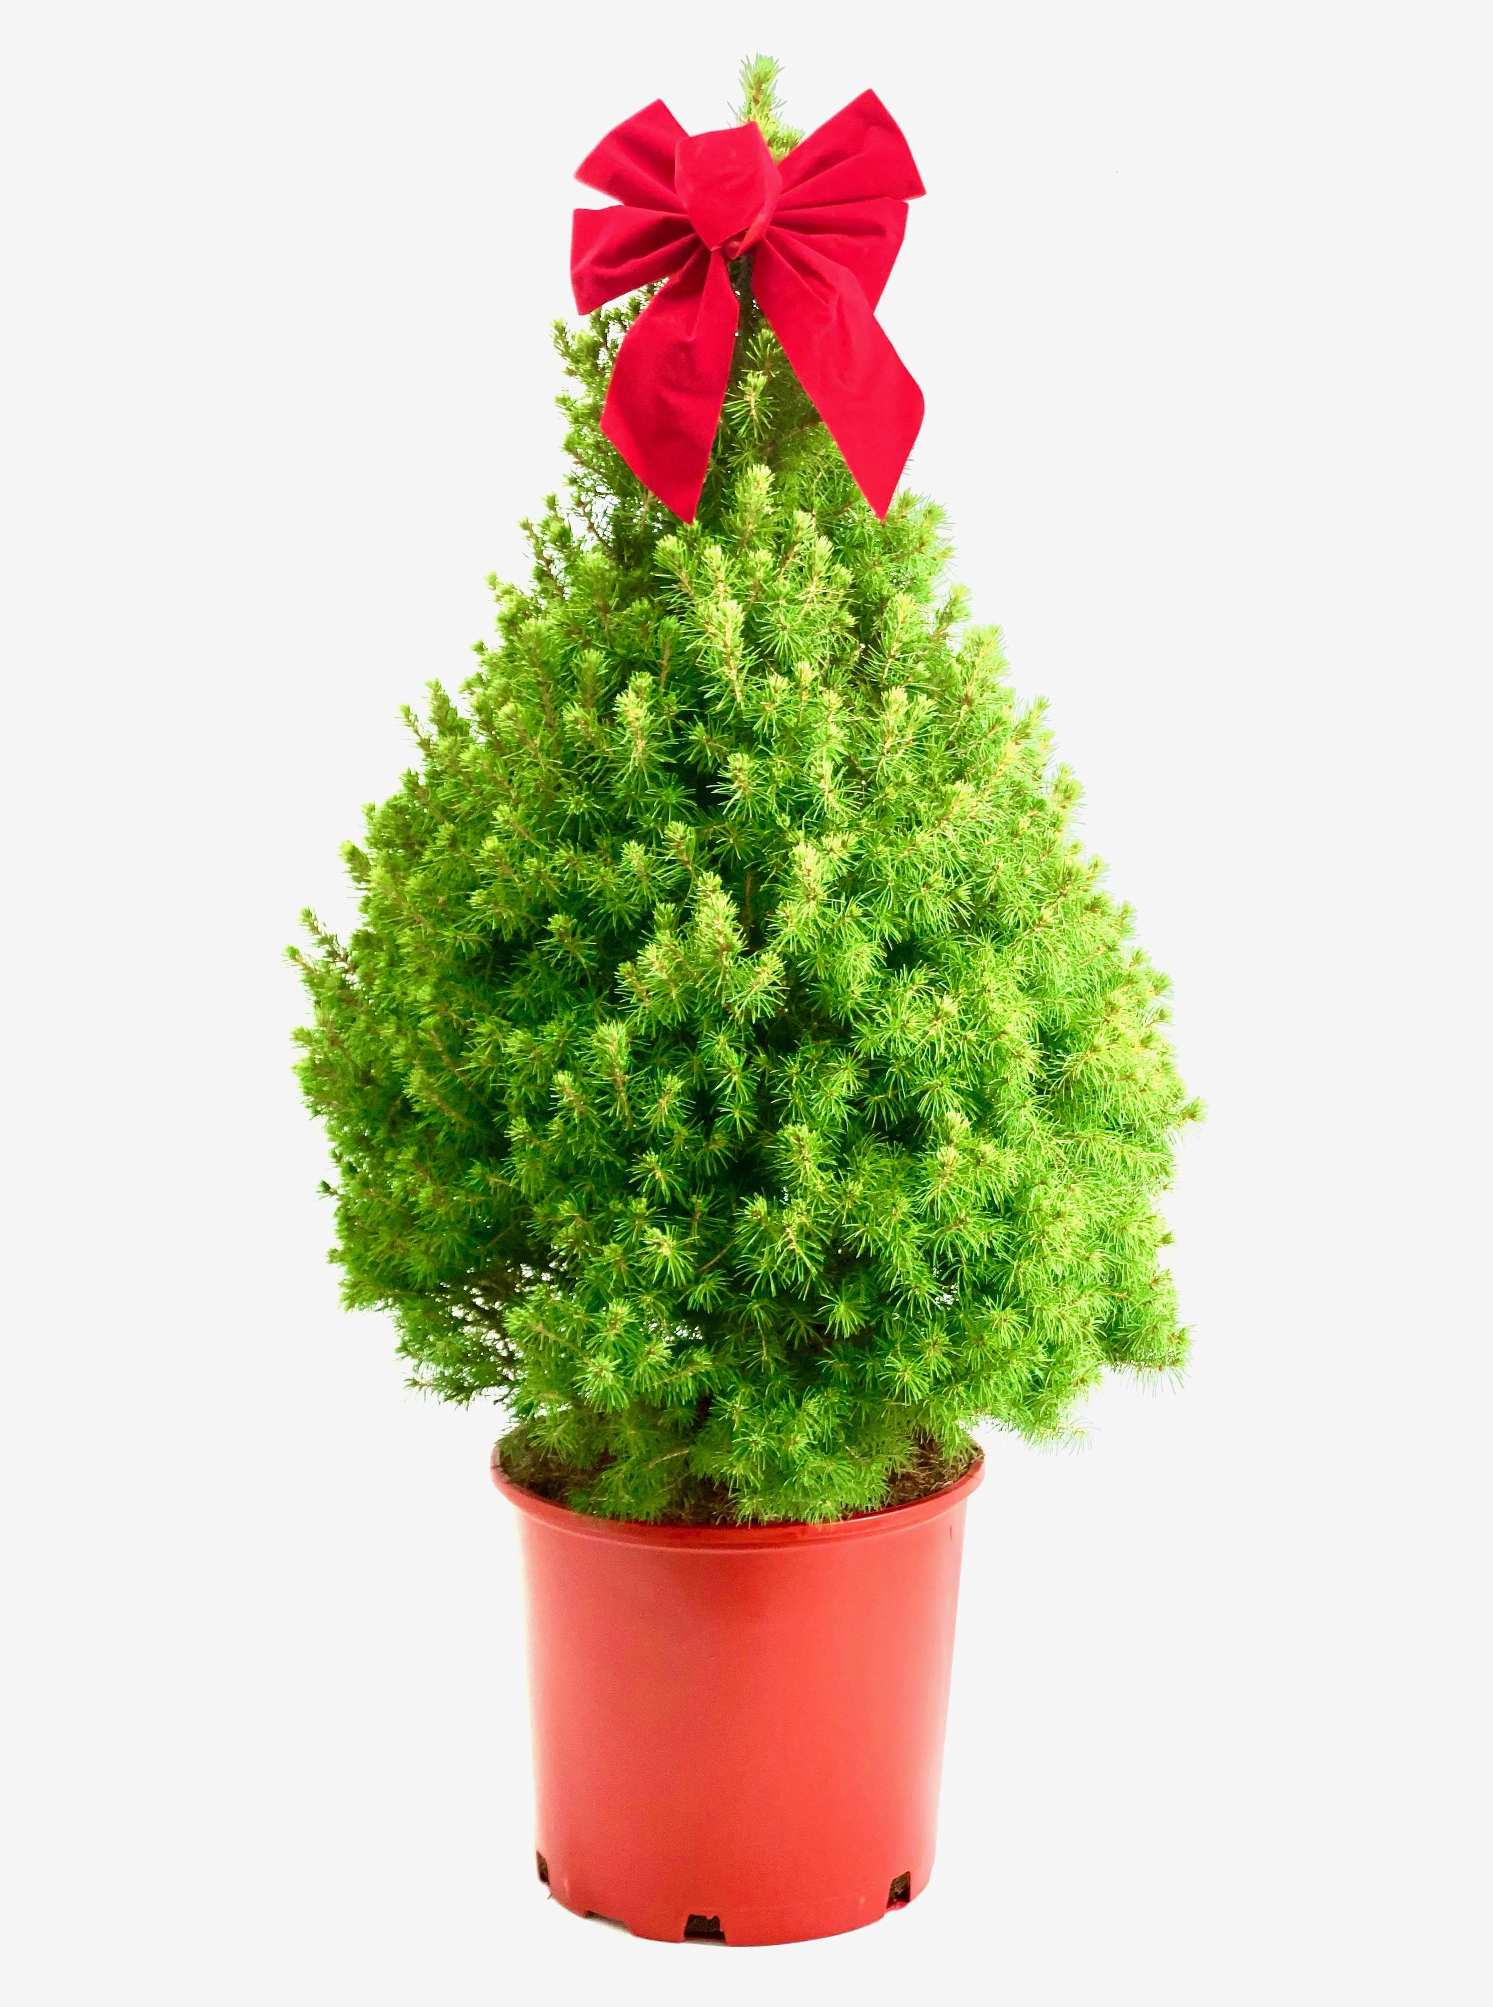
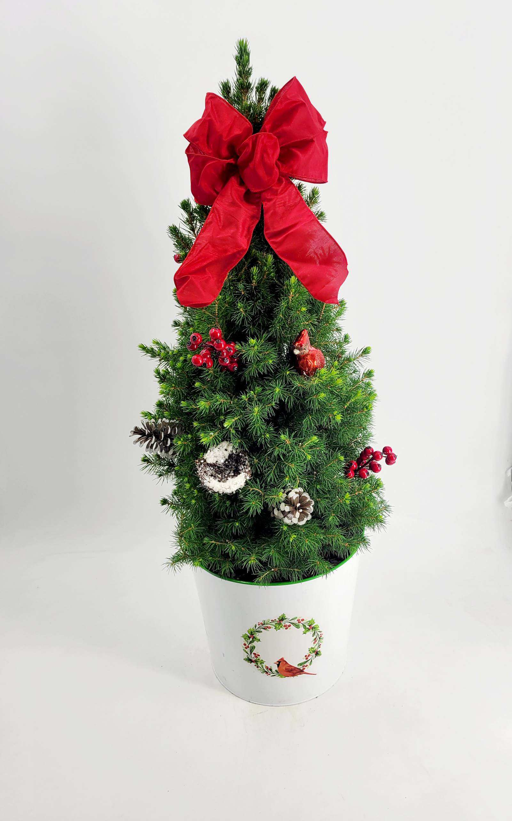
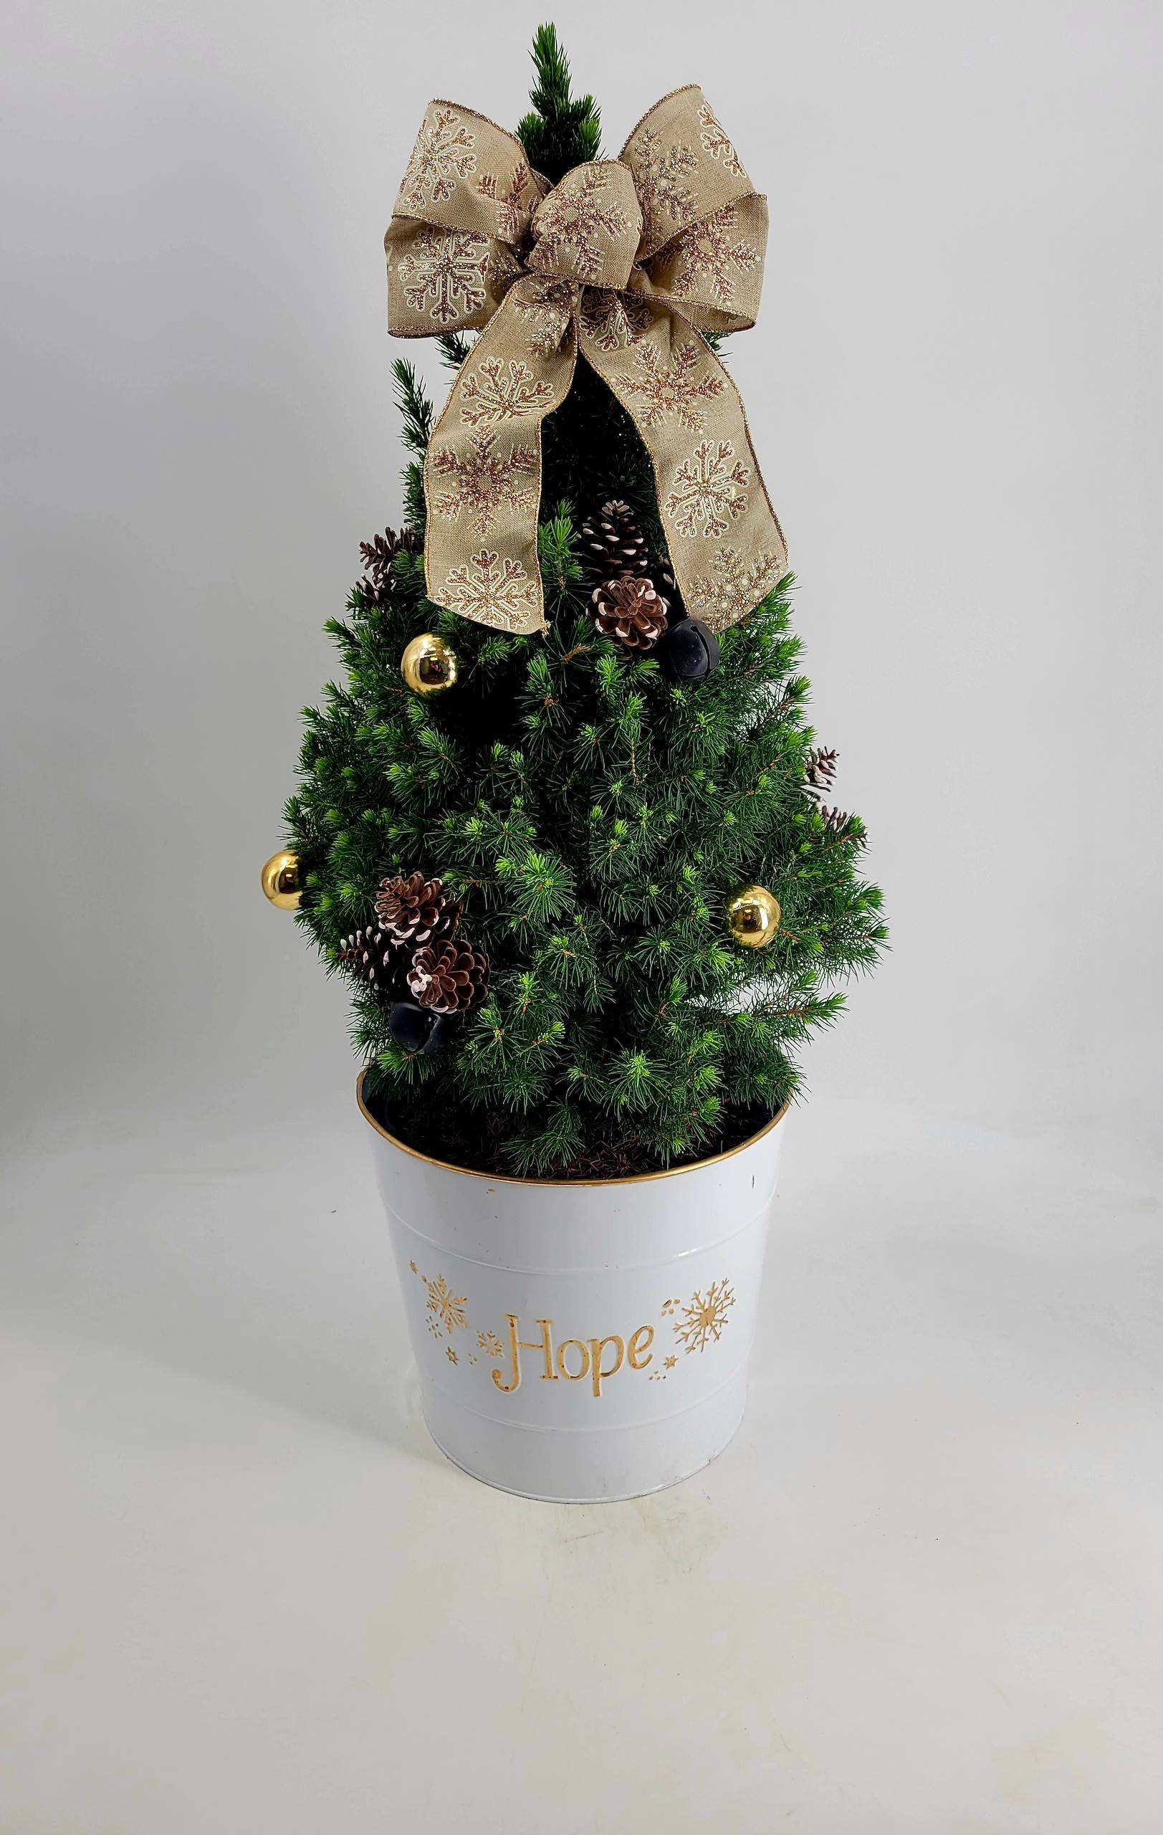
**PLEASE NOTE DECO POT IS DESIGNER’S CHOICE
PICEA HOLIDAY CONICA RED POT 3 CONT.
$30.00
PICEA HOLIDAY CONICA 3 DECO POT
$37.50

Slide 8
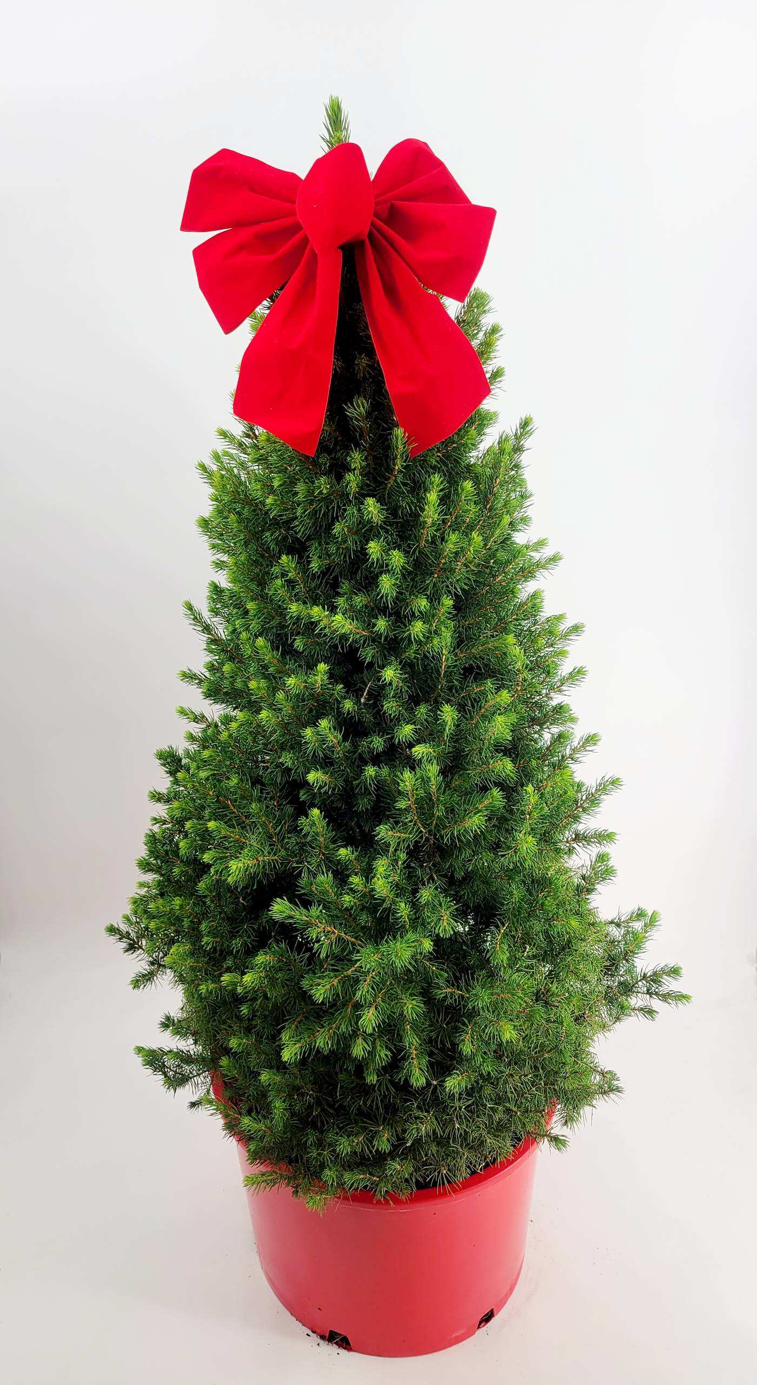
PICEA HOLIDAY CONICA RED POT #7 CONT.
$62.50

Slide 9
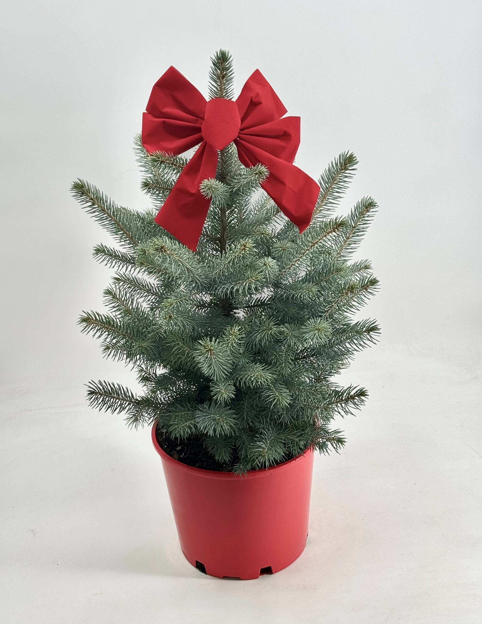
PICEA PUNGENS HOLIDAY BABY BLUE 3
$35.75

Slide 10
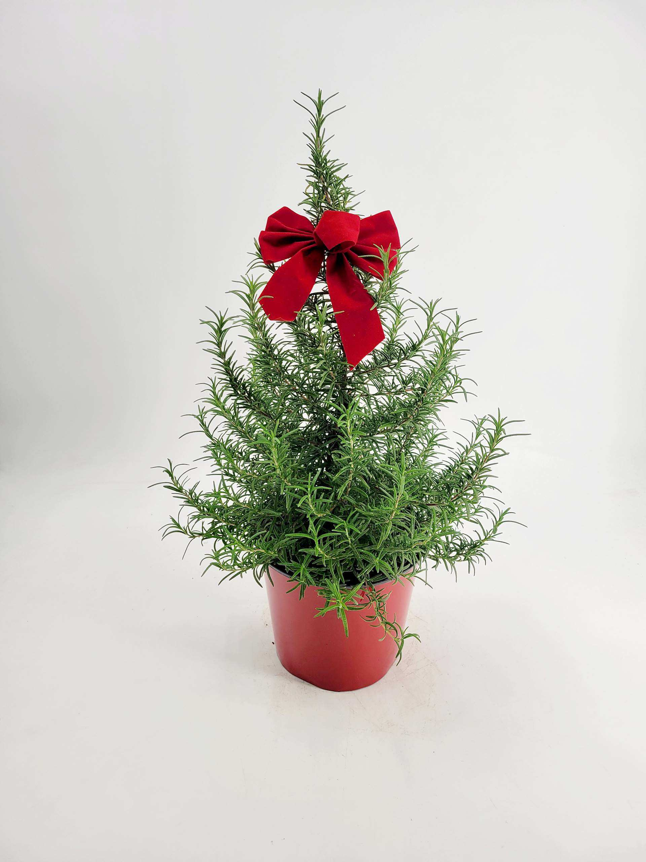
ROSEMARY HOLIDAY RED POT 1 CONT.
$8.75
ROSEMARY HOLIDAY RED POT 2 CONT.
$16.00

Slide 11

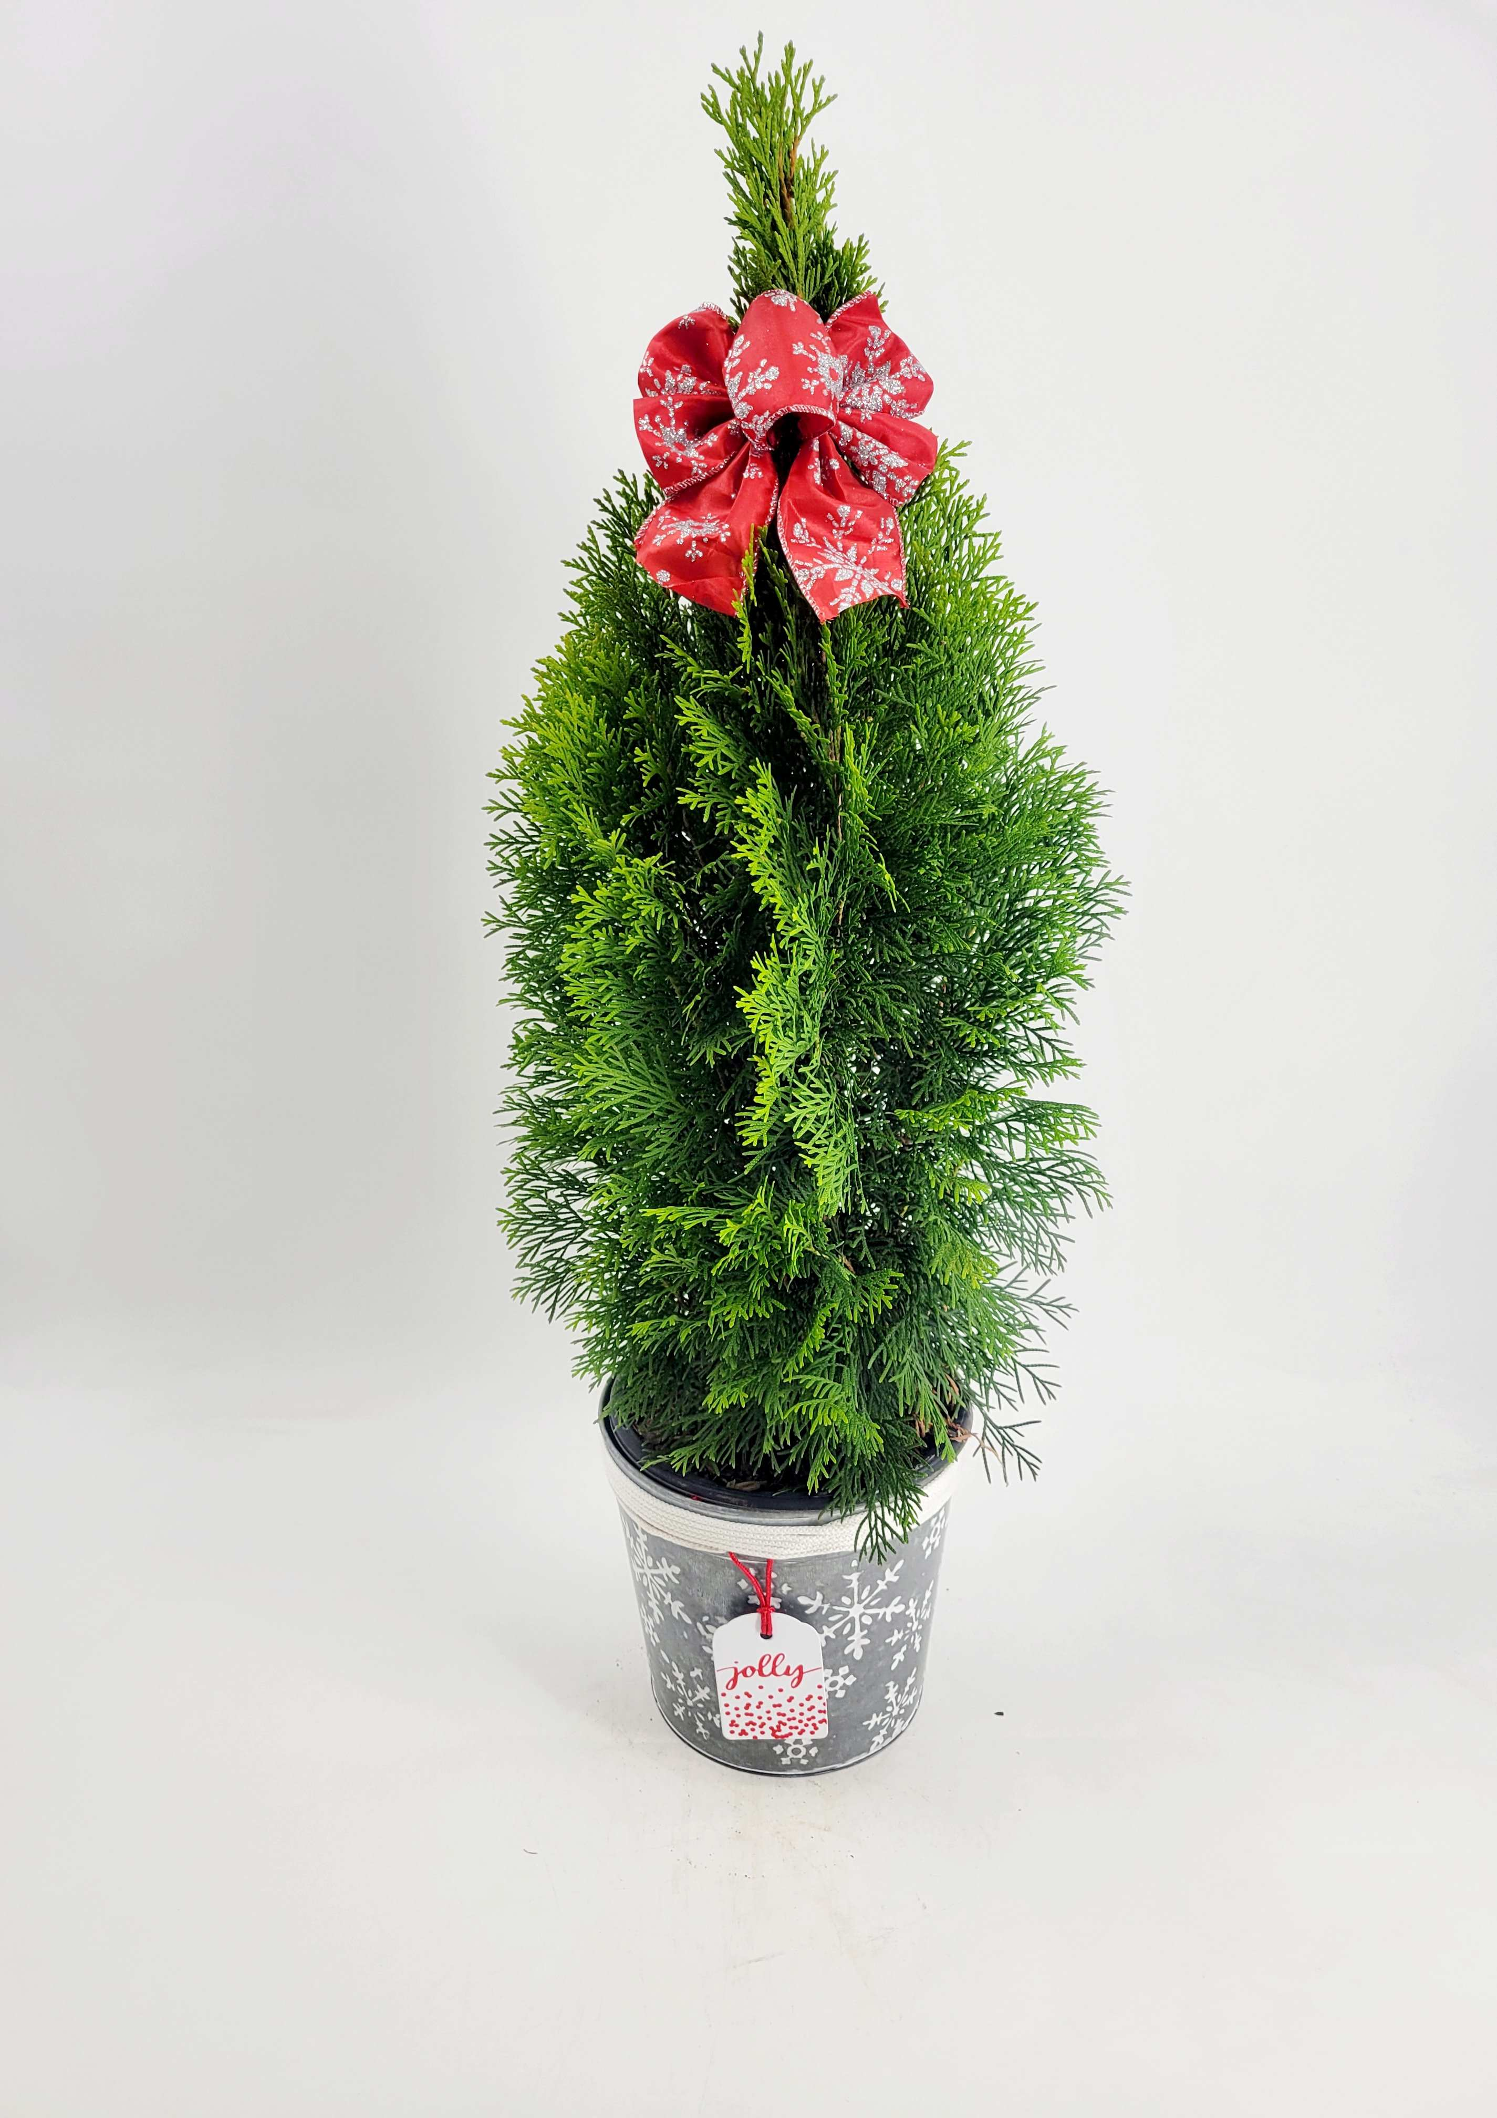
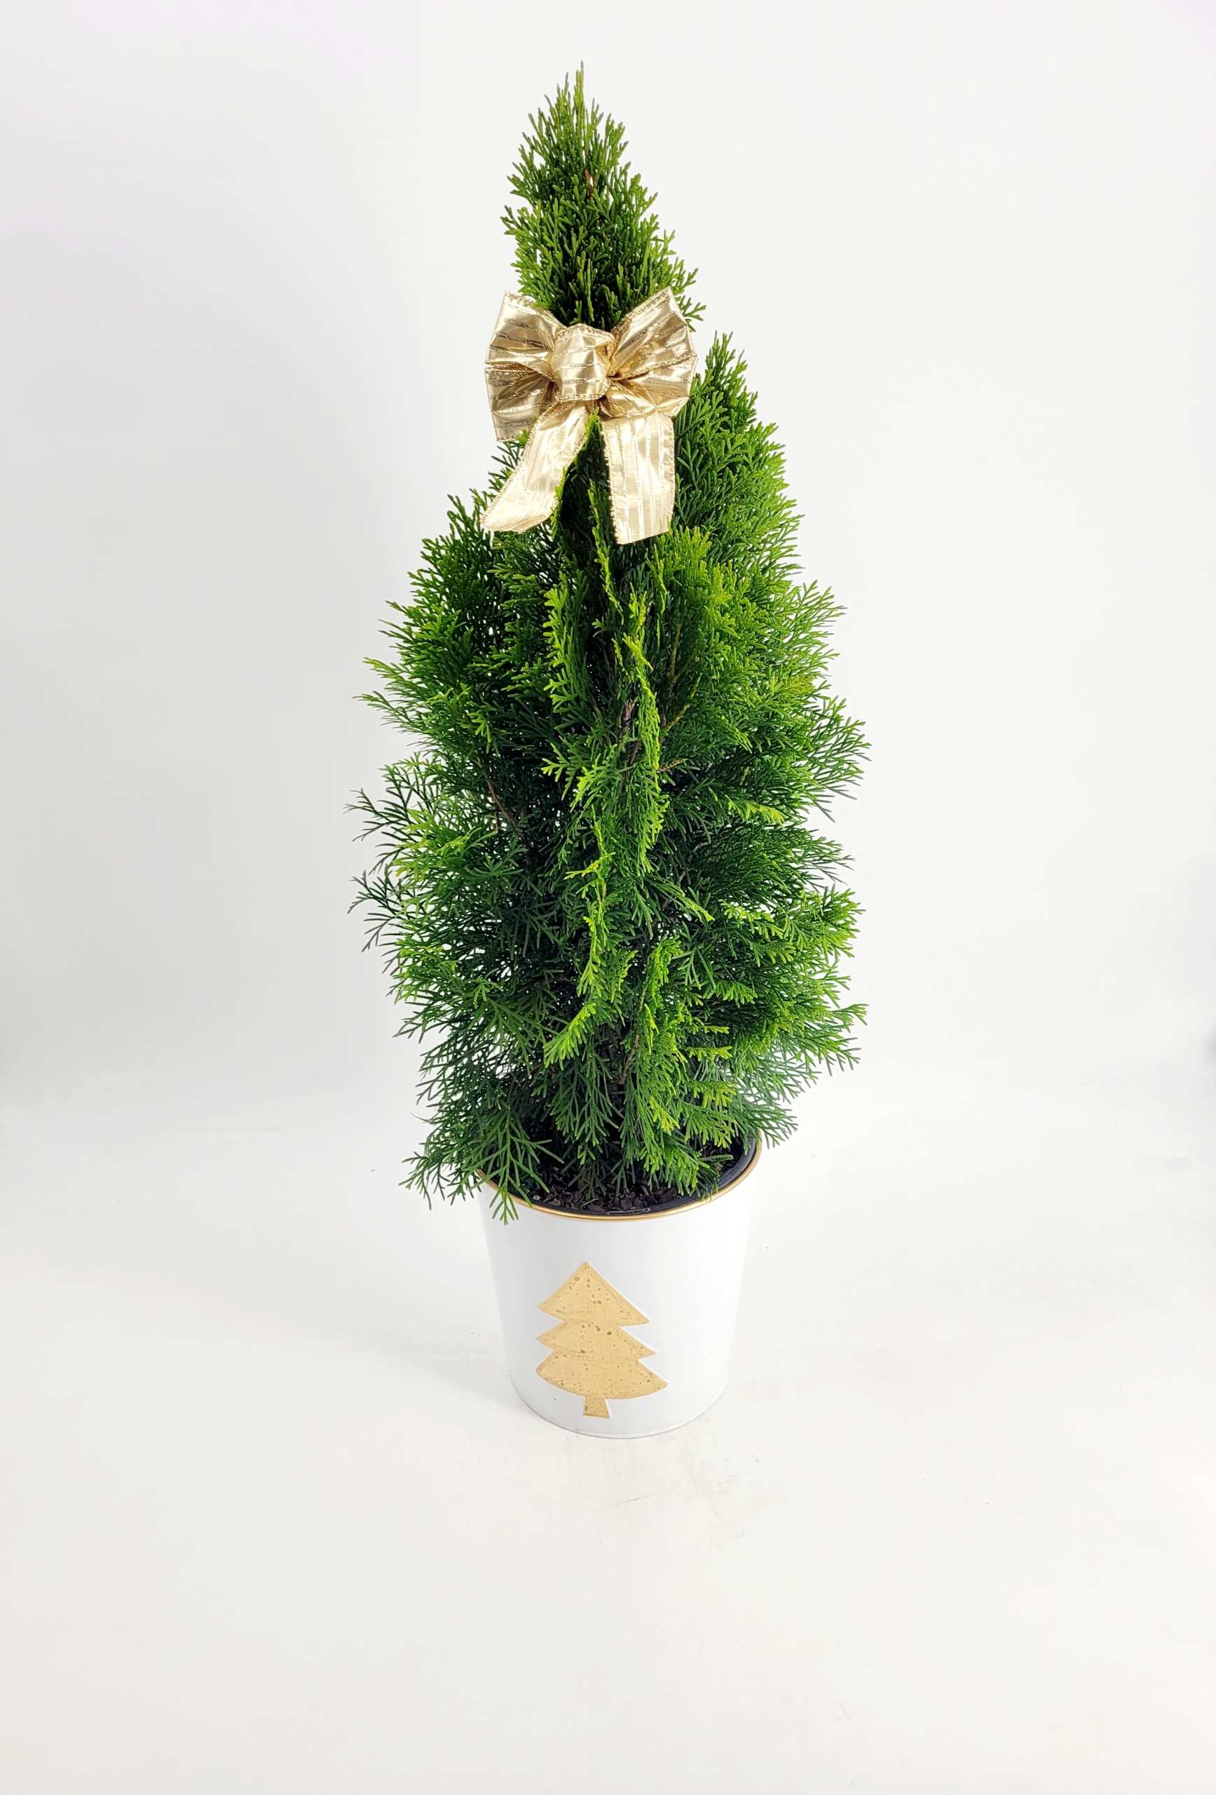
**PLEASE NOTE DECO POT IS DESIGNER’S CHOICE
THUJA HOLIDAY 1 RED POT
$8.50
THUJA HOLIDAY 1 DECO POT
$11.00

Slide 12
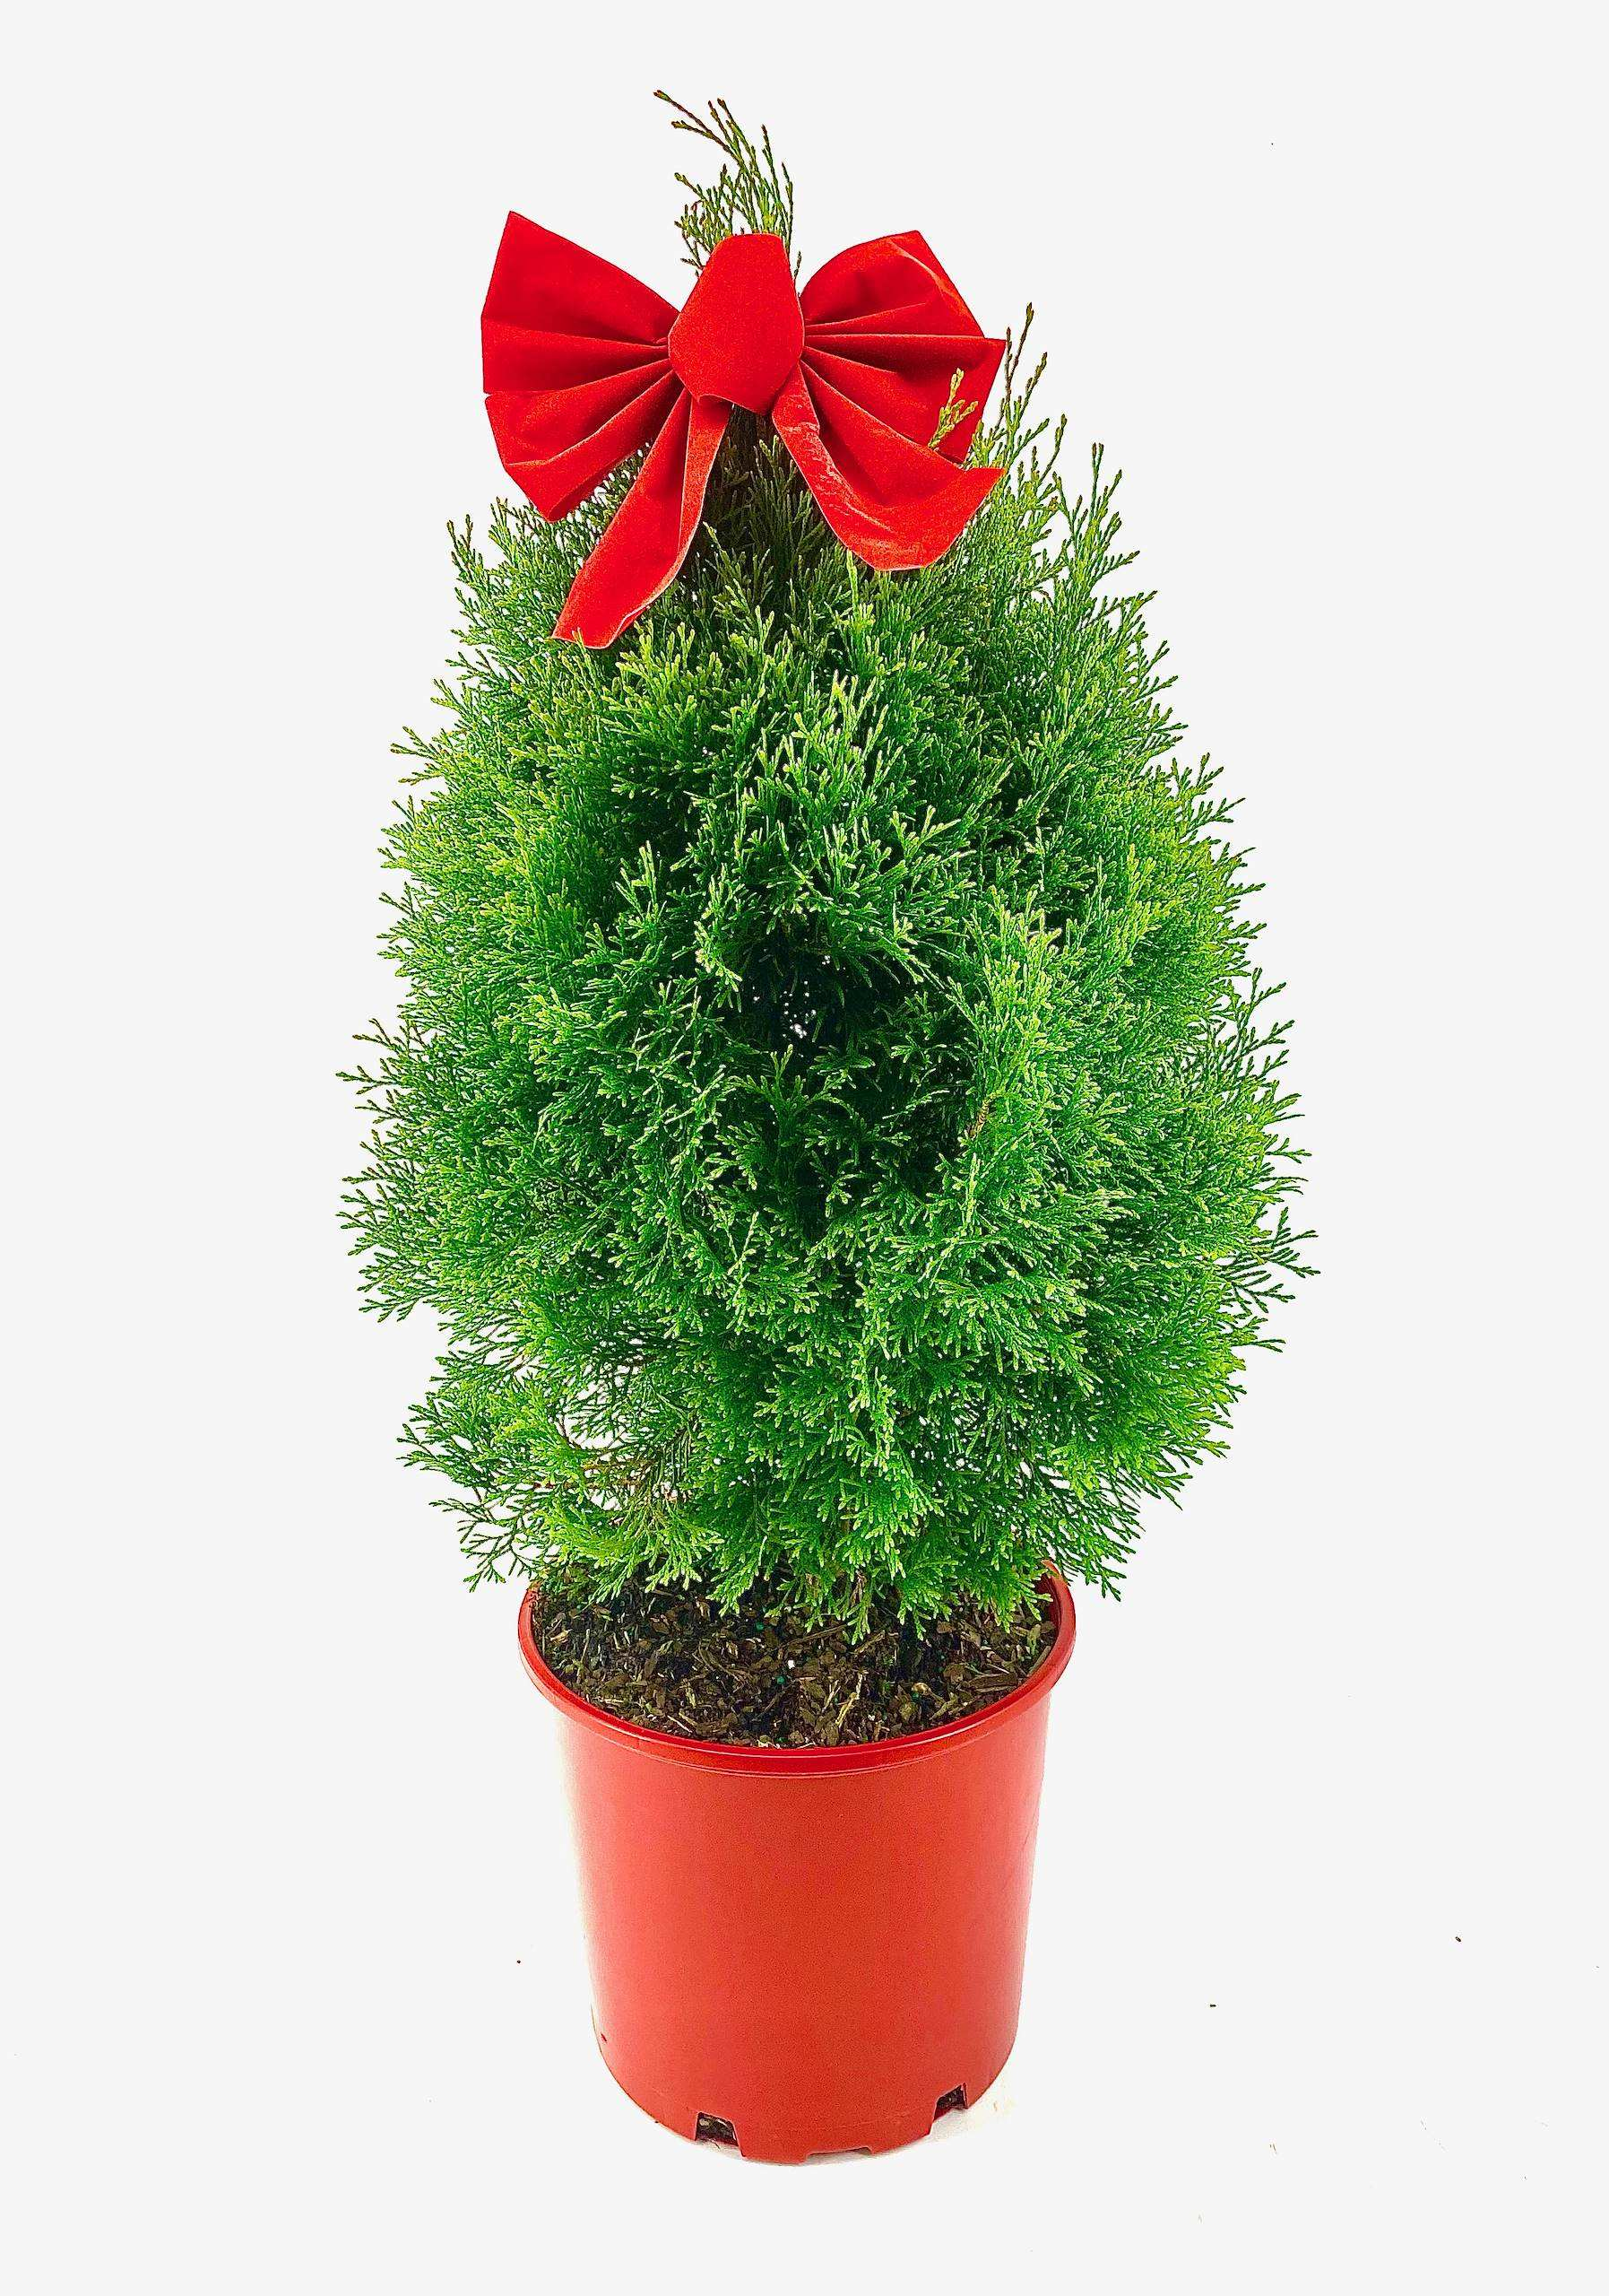
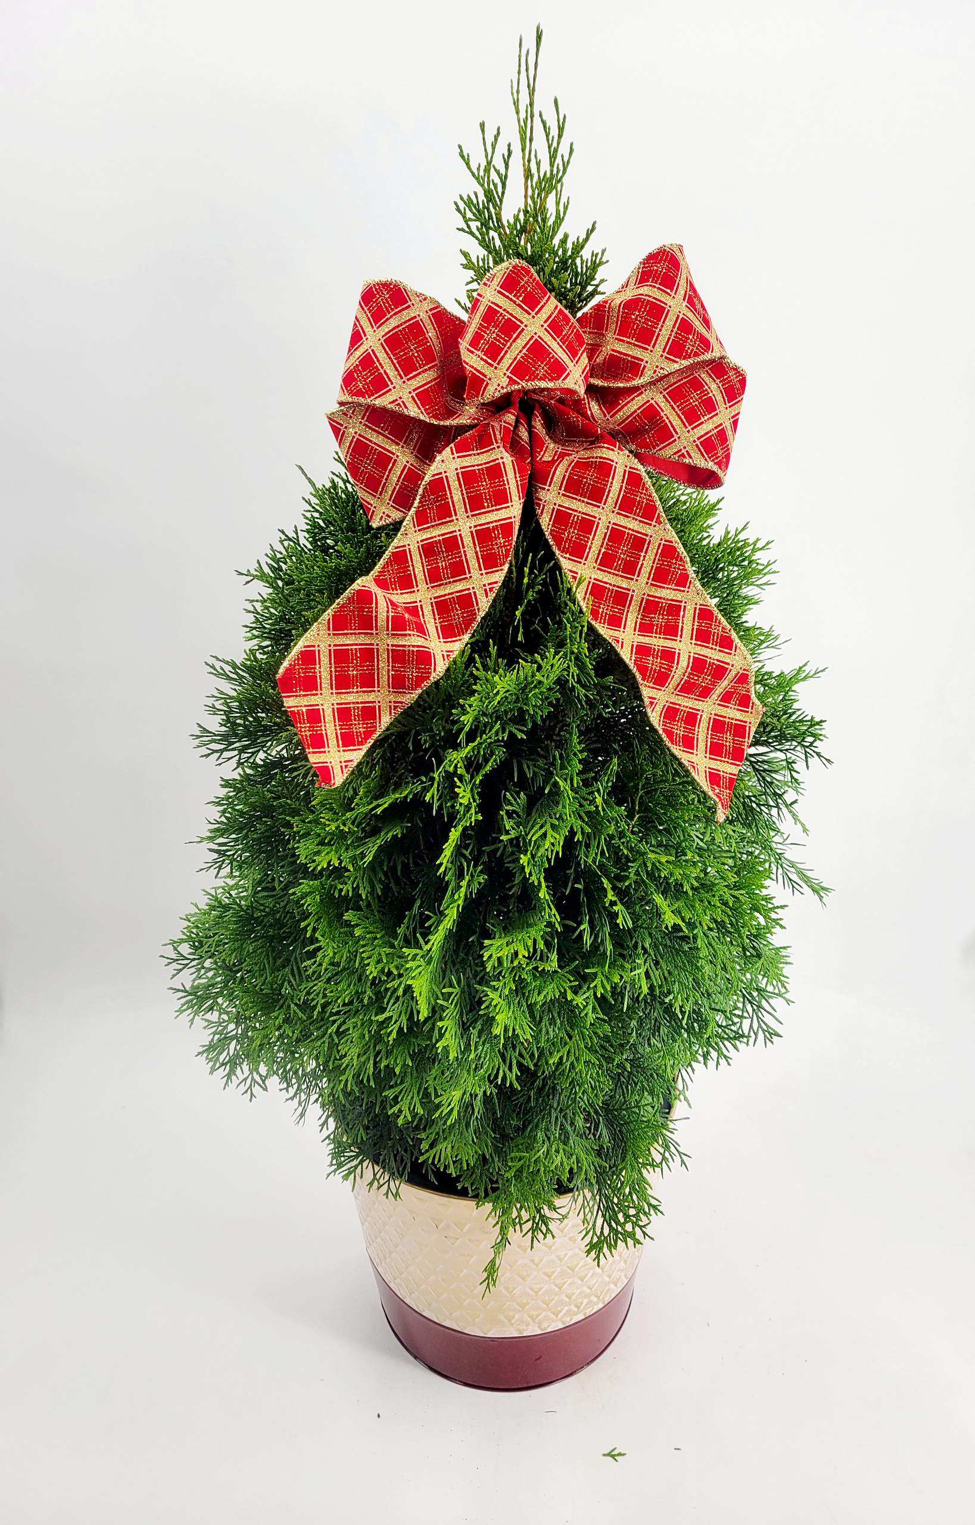
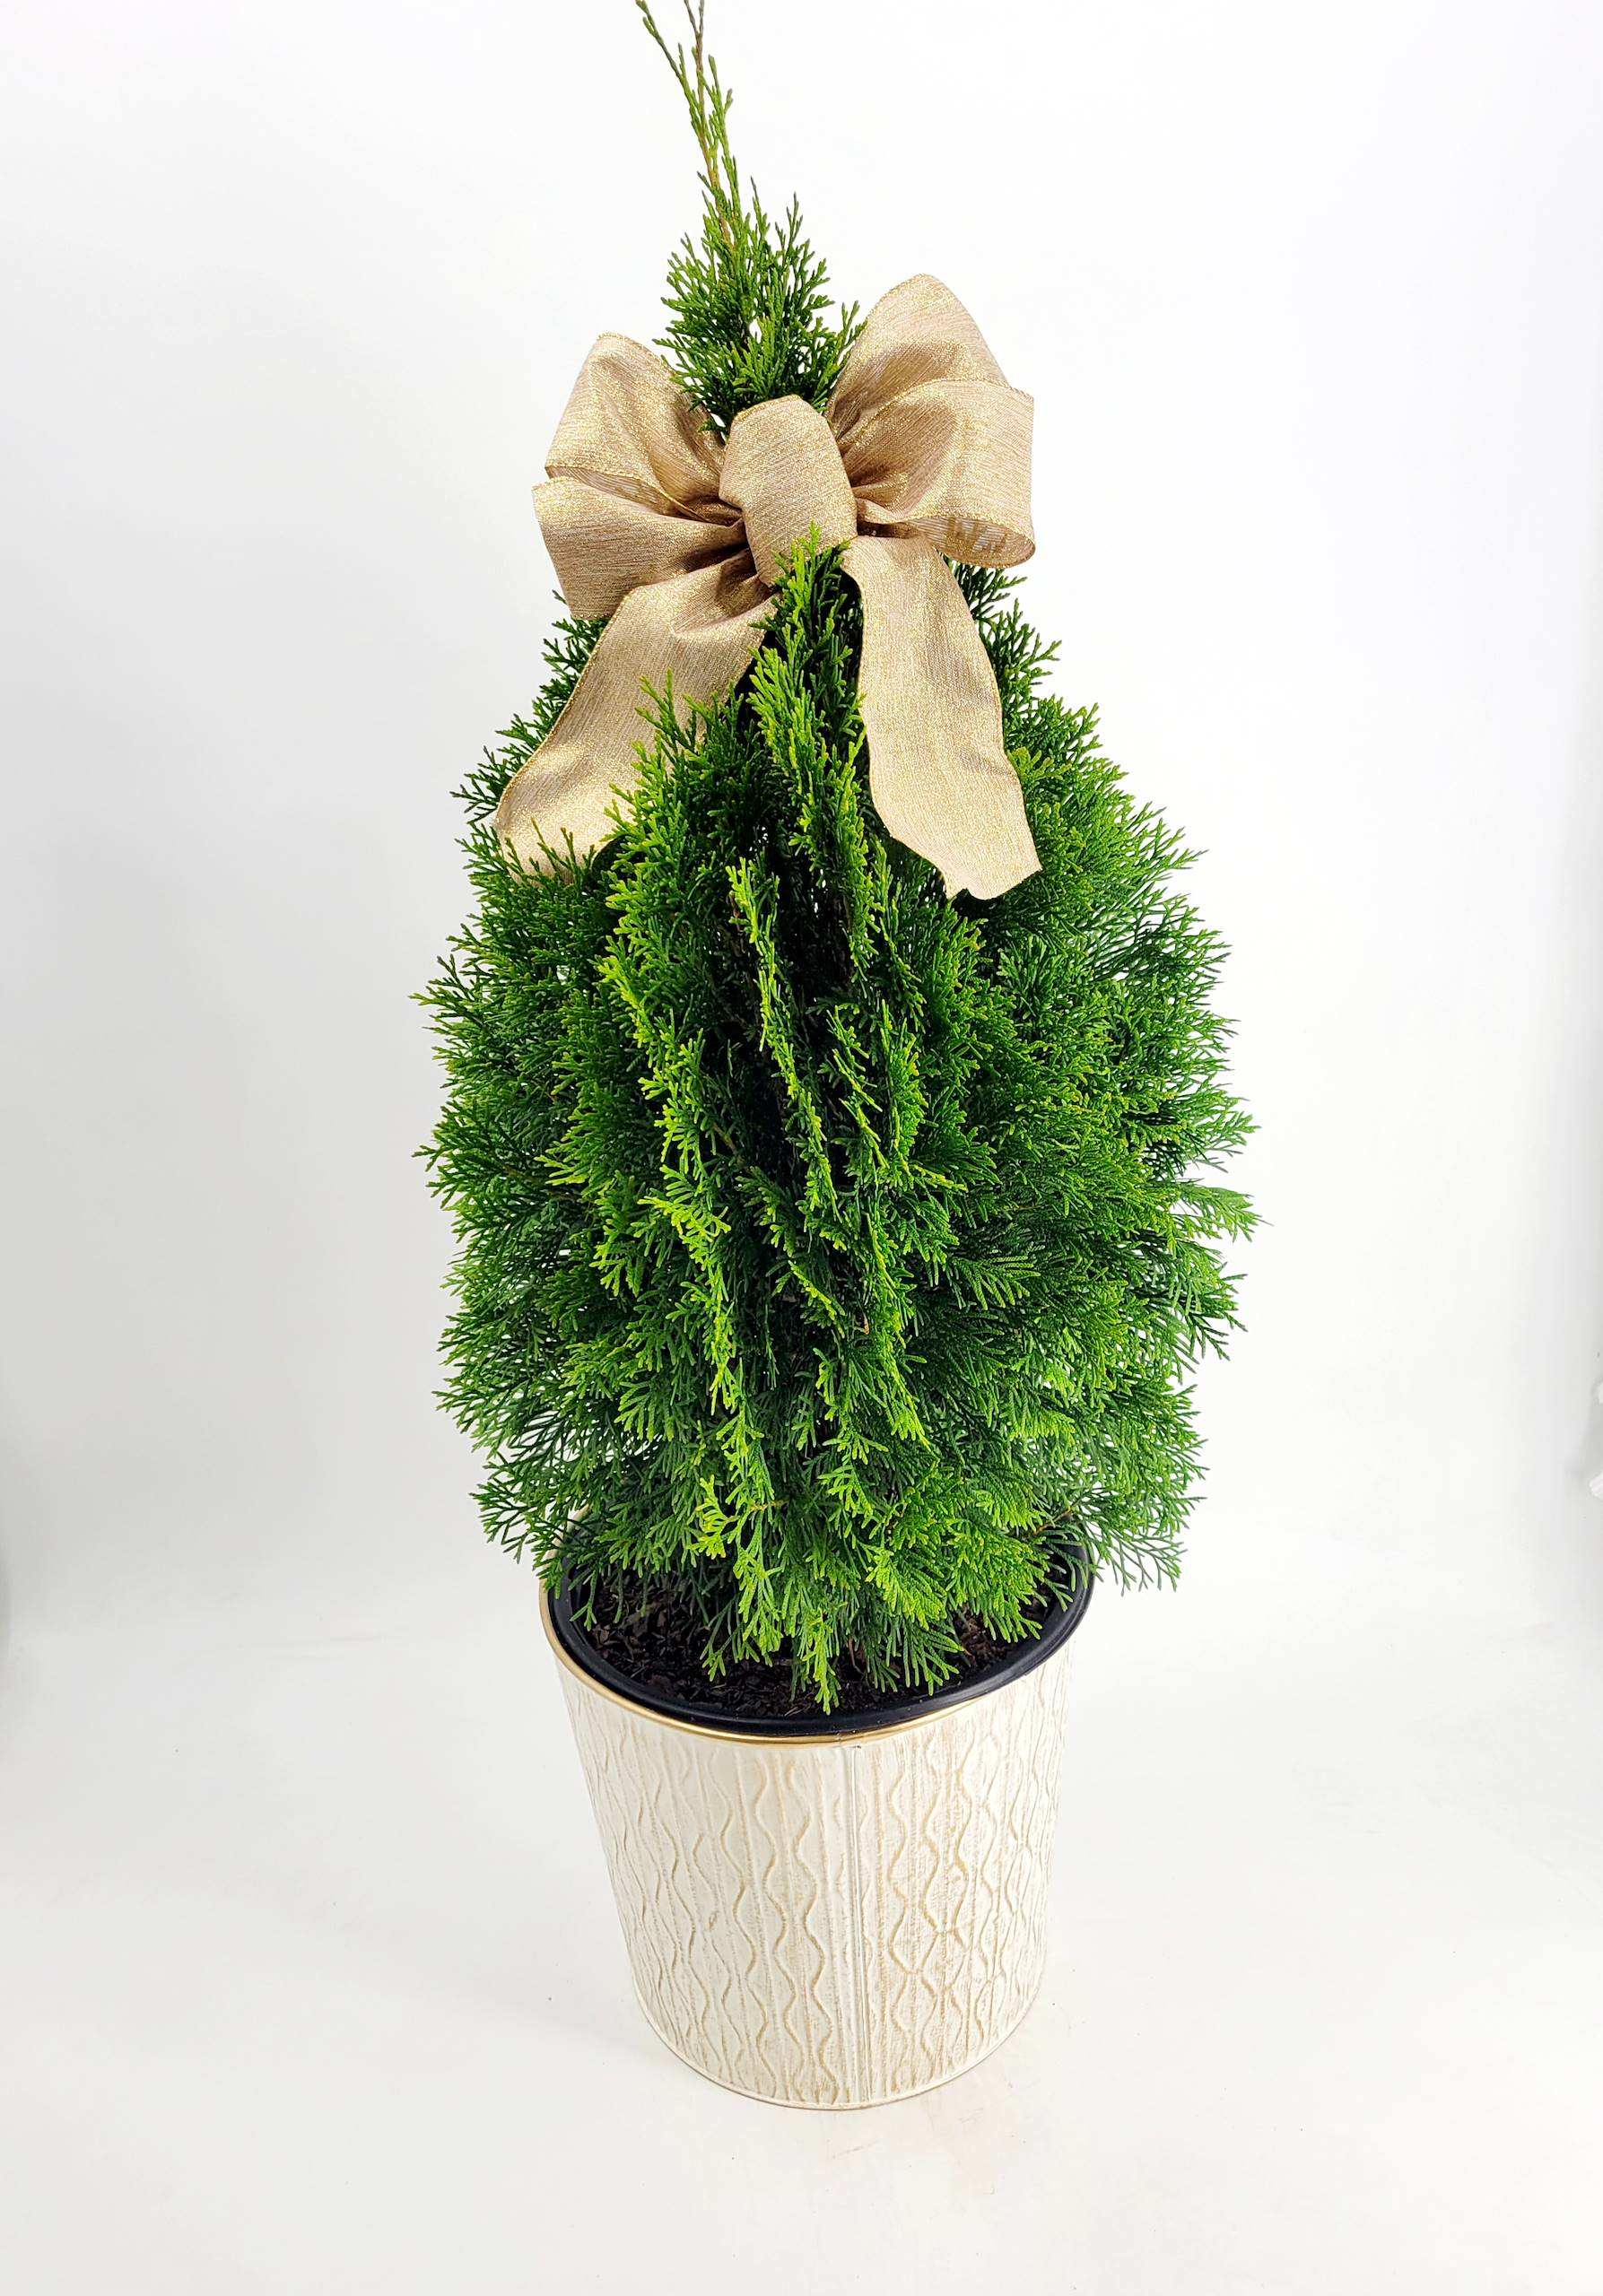
**PLEASE NOTE DECO POT IS DESIGNER’S CHOICE
THUJA HOLIDAY RED POT 3 CONT.
$19.75
THUJA HOLIDAY 3 DECO POT
$25.00

Slide 13
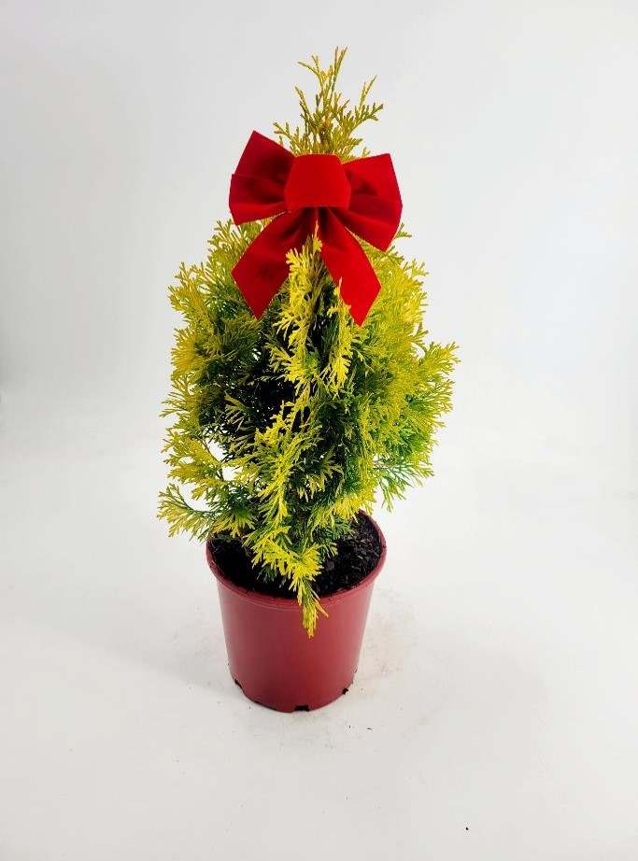
THUJA JANTAR HOLIDAY RED POT 3
$23.75

Slide 14
HAPPY HOLIDAYS

